Slide 1
Random Walk based Proximity Measures in Directed Graphs
Speaker: 李 寰
Notes:
Hi I am going to talk about finding nearest neighbors in large graphs very very quickly. This is joint work with …

Slide 2




Recommender systems¹
Alice
What are the top k movie recommendations for Alice in IMDB?
Bob
Charlie
1. M. Brand. A random walks perspective on maximizing satisfaction and profit. SIAM ‘05.
Notes:
Lets start with a few examples which require ranking on large graphs. Take for example recommender networks.
Here we have a bipartite graph of customers and movies. A customer has a link to a movie if he/she rated that movie. Now the question is…

Slide 3
Content-based search in databases^{1, 2}
maximum
paper-has-word
Find top k papers matching “SVM” in DBLP
margin
Paper #1
classification
paper-cites-paper
paper-has-word
large
Paper #2
scale
SVM
1. S. Chakrabarti. Dynamic personalized pagerank in entity-relation graphs. WWW ‘07.
2. A. Balmin, V. Hristidis, & Y. Papakonstantinou. ObjectRank: Authority-based keyword search in databases. VLDB ‘04.
Notes:
Another example is content based search in databases. We can represent the citeseer dataset by a graph of paper and word-nodes. Papers are connected via citation. Words are connected to the paper if they appeared in the title of the paper. Now we want to ask….

Slide 4
Random walk based proximity measures in directed graphs
Personalized pagerank
G. Jeh & J. Widom (WWW ’03)
Truncated hitting and commute times
P. Sarkar, A. Moore, & A. Prakash (ICML ’08)
Escape probability
H. Tong, Y. Koren, & C. Faloutsos (KDD ’07)
Notes:
Lets start with a few examples which require ranking on large graphs. Take for example recommender networks.
Here we have a bipartite graph of customers and movies. A customer has a link to a movie if he/she rated that movie. Now the question is…

Slide 5

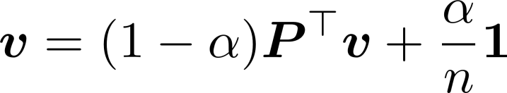


Personalized pagerank
Stationary distribution
Pagerank¹
Rank web-pages by distribution satisfying
Personalized pagerank²
Using a non-uniform restart distribution
e.g. when computing proximity from node i
1. S. Brin & L. Page. The anatomy of a large-scale hypertextual web search engine. WWW ‘98.
2. G. Jeh & J. Widom. Scaling personalized web search. WWW ’03.
Notes:
Lets start with a few examples which require ranking on large graphs. Take for example recommender networks.
Here we have a bipartite graph of customers and movies. A customer has a link to a movie if he/she rated that movie. Now the question is…

Slide 6





Hitting and commute times
Hitting time
Expected length of the path
Commute time
Expected length of the path
Drawbacks^{1, 2}
Take into account very long paths
is small whenever has a large stationary probability
Alice likes cartoons, so her top 10 recommendations should not be the 10 most popular movies
1. D. Liben-Nowell & J. Kleinberg. The link predication problem for social networks. CIKM ‘03.
2. M. Brand. A random walks perspective on maximizing satisfaction and profit. SIAM ’05.
Notes:
Lets start with a few examples which require ranking on large graphs. Take for example recommender networks.
Here we have a bipartite graph of customers and movies. A customer has a link to a movie if he/she rated that movie. Now the question is…

Slide 7

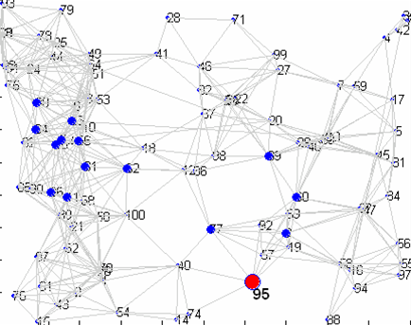
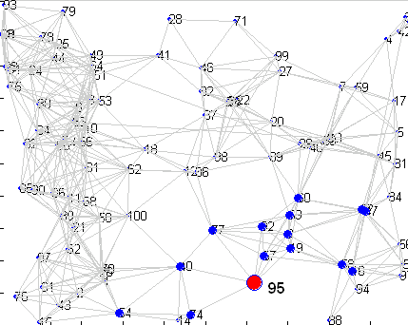
Truncated hitting and commute times¹
Truncated version of hitting time and commute times
Only considers paths of length at most
Random walk gets lost here.
a) Un-truncated hitting time
b) Truncated hitting time
1. P. Sarkar, A. Moore, & A. Prakash. Fast Incremental Proximity Search in Large Graphs. ICML ‘08.
Notes:
Lets start with a few examples which require ranking on large graphs. Take for example recommender networks.
Here we have a bipartite graph of customers and movies. A customer has a link to a movie if he/she rated that movie. Now the question is…

Slide 8

Escape probability¹
The escape probability from node A to node B
Denoted as
Prob (starting at A, reaches B before returning to A)
the remaining
graph
A
B
1. H. Tong, Y. Koren, & C. Faloutsos. Fast direction-aware proximity for graph mining. KDD ‘07.

Slide 9
Asymmetry of escape probability
Notes:
Lets start with a few examples which require ranking on large graphs. Take for example recommender networks.
Here we have a bipartite graph of customers and movies. A customer has a link to a movie if he/she rated that movie. Now the question is…

Slide 10



Issue 1: “Degree-1 node” effect
Introduce an absorbing node

Slide 11
Issue 2: Weakly connected pair
Partial symmetry
Notes:
Lets start with a few examples which require ranking on large graphs. Take for example recommender networks.
Here we have a bipartite graph of customers and movies. A customer has a link to a movie if he/she rated that movie. Now the question is…

Slide 12



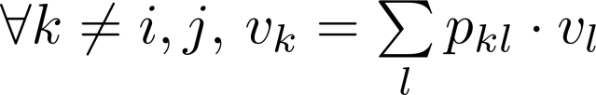
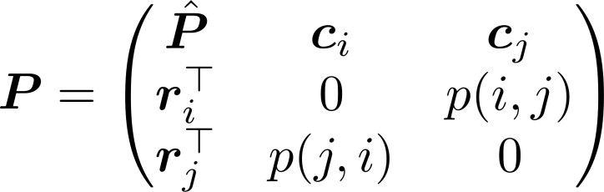



Solving ep(i -> j)
The generalized voltage
Calculating
, ,
Split and
Then
Computing all requires
matrix inversions
Notes:
Lets start with a few examples which require ranking on large graphs. Take for example recommender networks.
Here we have a bipartite graph of customers and movies. A customer has a link to a movie if he/she rated that movie. Now the question is…

Slide 13
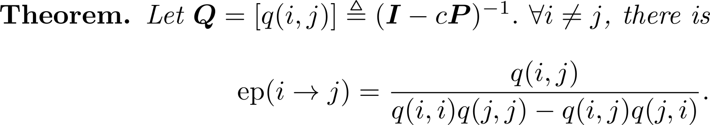


Fast solution for all-pair proximities
Proved by Block Matrix Inversion Lemma
Fast solution to all-pair proximilities
Compute
For all pair of nodes, compute
Time complexity
Notes:
Lets start with a few examples which require ranking on large graphs. Take for example recommender networks.
Here we have a bipartite graph of customers and movies. A customer has a link to a movie if he/she rated that movie. Now the question is…

Slide 14

Fast solution for one-pair proximity
….
x
x
x
Fast solution to one-pair proximility
Only need two columns of Q
Taylor expansion
Computing i^{th} column of Q
Time complexity
Notes:
Lets start with a few examples which require ranking on large graphs. Take for example recommender networks.
Here we have a bipartite graph of customers and movies. A customer has a link to a movie if he/she rated that movie. Now the question is…

Slide 15
Experimental results
Effectiveness
Link Prediction
Existence
Direction
Efficiency
Fast all-pair proximities
Fast one-pair proximity
Notes:
We want to check both the effectiveness and efficiency of our DAP.

Slide 16
Datasets (all real)
Name | Node # | Edge # | Directionality
WL | 4k | 10k | A-links to-B
PC | 36k | 64k | Who-contact-whom
EP | 76k | 509k | Who-trust-whom
CN | 28k | 353k | A-cites-B
AE | 38k | 115k | Who-email to-whom
Notes:
Now we will show some experimental results to
We use five datasets and all of them are directed, such as web-link graph, who-trust-whom, who-emails-to whom and so on.

Slide 17

Link Prediction: existence
density
with link
DAP is effective to distinguish red and blue
density
no link

Slide 18
Link Prediction: existence
Q: Given a pair of nodes i and j, is there a link between j and j?
A: Yes iff reaches a given threshold
Dataset | Accuracy
WL | 65.40%
PC | 79.60%
AE | 81.51%
CN | 86.71%
EP | 92.21%

Slide 19


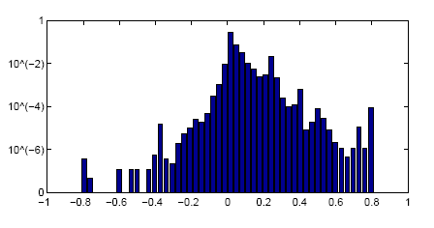
Link Prediction: direction
Q: Given the existence of the link between i and j, what is the direction of the link?
A: Compare and , pick the greater one
>70%
density
Prox (i→j) - Prox (j→i)

Slide 20
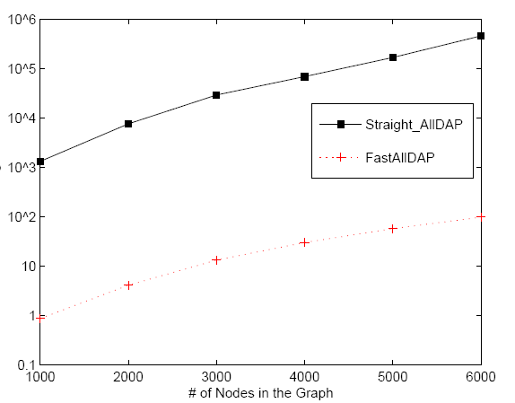
Efficiency: Fast all-pair proximities
Time (sec)
Straight-Solver
1,000x
faster!
FastAllDAP
Size of Graph

Slide 21
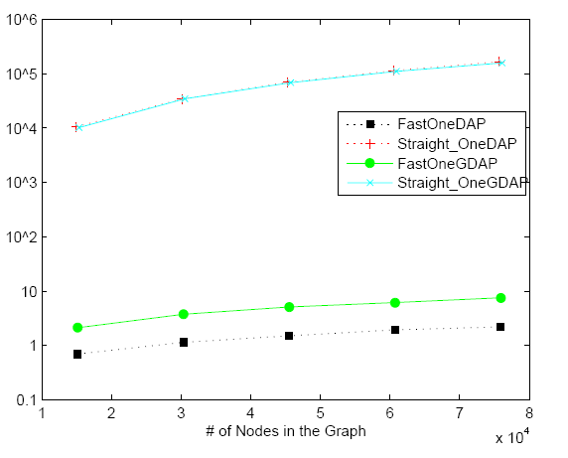
Efficiency: Fast one-pair proximity
Time (sec)
Straight-Solver
1,0000x
faster!
FastOneDAP
Size of Graph
Notes:
Similar observation for computing one single proximity

Slide 22
Relation to commute times
Intuitively¹
1. L. Lovász. Random walks on graphs: A survey. 1993.
Notes:
Lets start with a few examples which require ranking on large graphs. Take for example recommender networks.
Here we have a bipartite graph of customers and movies. A customer has a link to a movie if he/she rated that movie. Now the question is…

Slide 23
Relation to commute times
Proof¹
1. L. Lovász. Random walks on graphs: A survey. 1993.
Notes:
Lets start with a few examples which require ranking on large graphs. Take for example recommender networks.
Here we have a bipartite graph of customers and movies. A customer has a link to a movie if he/she rated that movie. Now the question is…

Slide 24
Relation to commute times
Notes:
Lets start with a few examples which require ranking on large graphs. Take for example recommender networks.
Here we have a bipartite graph of customers and movies. A customer has a link to a movie if he/she rated that movie. Now the question is…

Slide 25
The End

